Slide 1
Human Performance Models
RMSP

Slide 2
Need
Diversity of human abilities
Personalities
Work-styles
  Together challenge the designers
RMSP

Slide 3
Performance Models
Physical Abilities and Physical workplaces
Cognitive and perceptual abilities
Personality Differences
Cultural and international diversity
Users with disabilities
Elderly Users
RMSP

Slide 4
Physical Abilities
Anthropometry
  Basic data about human dimensions
Measured using
  Static Measures
  Dynamic Measures
  Perception
RMSP

Slide 5
Static Measures
Male vs Female, Young vs Adult
Underweight vs Overweight
Tall vs short
  Eg: Screen Brightness Preference
  Eg : design of keyboard
    Parameters – distance between keys, size of keys, required pressure
RMSP

Slide 6
Dynamic Measures
Measuring the action
  Reach distance while seated
  Speed of finger presses
  Strength of lifting
RMSP

Slide 7
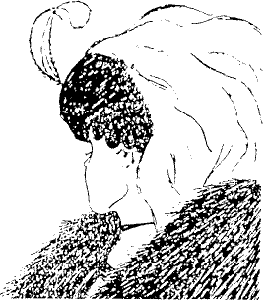
Perception
RMSP

Slide 8


Perception – contd.
RMSP

Slide 9

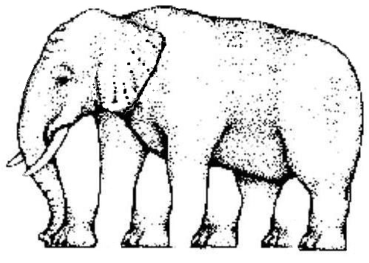
Perception
RMSP

Slide 10
Perception – contd.
Varies from person to person
Vision
  Time to adapt to bright or low light
  Response to color
  Impact of glare
Depth Perception
  3-D views
Viewing Angles
RMSP

Slide 11
Other Physical Abilities
Eye disorders
Touch of keyboard
Hearing for audible tones
Touch screen Entry
Speech input and Output
RMSP

Slide 12
Physical Workplaces
Workplace design ensures
  High job satisfaction
  High performance
  Low error rates
Physical environment – room layout
Sociology of human interaction
RMSP

Slide 13
Cognitive
Sub-discipline of psychology
exploring internal mental processes
Goals
  Promote Retention
  Promote Transfer
RMSP

Slide 14
Cognitive Processes
Consists of the taxonomy
  Remember
  Understand
  Apply
  Analyze
  Evaluate
  Create
RMSP

Slide 15
Personality Differences
4 personality types – Carl Jung
  Extroversion versus Introversion
  Sensing vs Intuition
  Perceptive vs Judging
  Feeling vs Thinking
RMSP

Slide 16
Personality Differences – contd.
Extroverts – focus on external stimuli
Introverts – prefer familiar patterns
Sensing – apply known skills
Intuitive – like solving new problems
Perceptive – learn new but troubled making decisions
Judging – careful plan
Feeling – aware of others
Thinking - unemotional
RMSP

Slide 17
Cultural and International Diversity
Internationalization
  Characters, numerals, special characters
  Left to right (vs) Right to left reading
  Date & time formats
  Numeric &currency formats
  Names & Title
  Punctuation
RMSP

Slide 18
Users with Disabilities
Text to Speech Conversion
Braille or Voice Output
Hearing Impairments – visual signals
Plan early
Source of information
  Private Foundations
  Associations
  Government Agencies
RMSP

Slide 19
Elderly Users
Understand human factors of aging
  Social interaction
  Communication
  Entertainment
  Writing
  Accounting
RMSP

Slide 20
Design Goals
Accommodating human diversity
Human centered development
Human evaluation
RMSP

Slide 21
Principles of Good Design
Good Design
  is Innovative
  makes a product useful
  is aesthetic
  Makes a product understandable
  Unobtrusive
  Honest
  Long lasting
  Thorough
  Environmentally Friendly
  As Little but better
RMSP

